Slide 1
Bond investment strategy
Alper YILDIRIM

Slide 2
Contents
Global Market Outlook
Portfolio Distribution
Portfolio Construction
Risk Considerations
Inflation and Interest Rate Risk
Strategy
Strategy
Credit Risk
Geopolitical Risk
Comparison
Monte Carlo Simulation
Liquidity Risk
Exchange Rate Risk

Slide 3
Portfolio constructıon

Slide 4
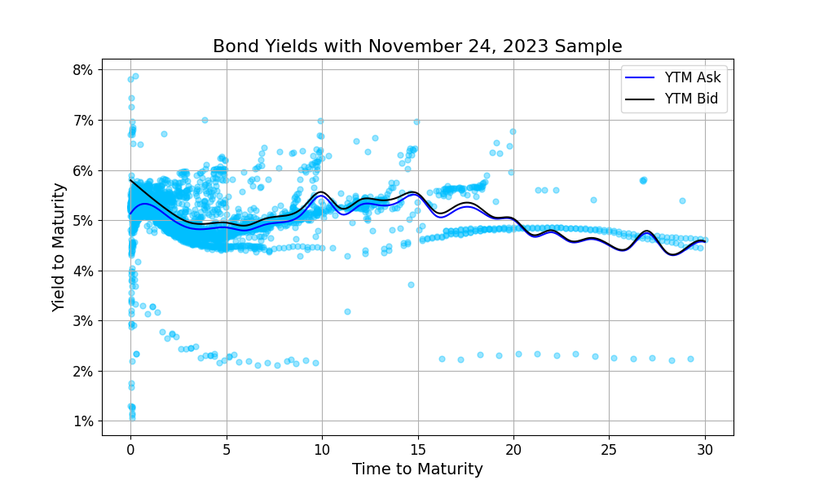
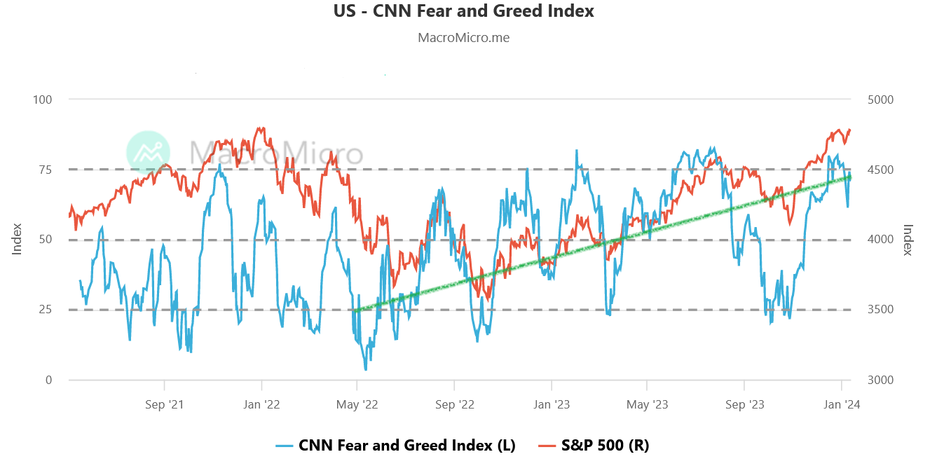
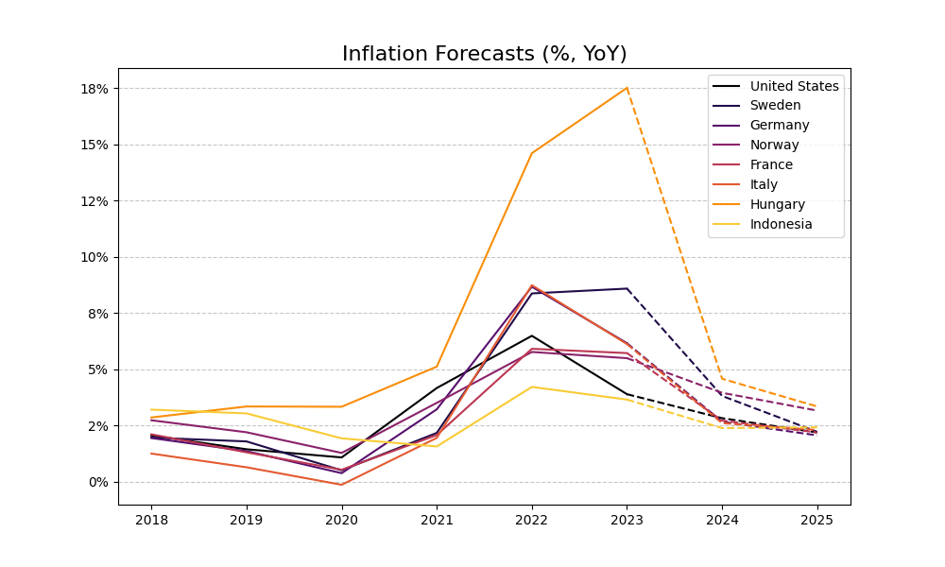
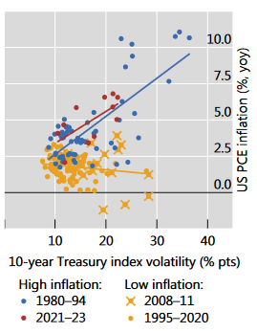
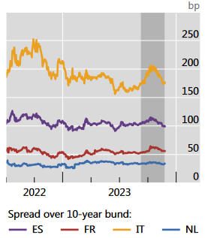
Global market outlook
Inflation ↓ ↔ Investor Sentiment ↑ ↔ Interest Rates ↓
Political agenda: Red Sea conflict, Taiwan elections and China, Russia-Ukraine War…
Source: CNN Business
Data Source: Bloomberg Terminal Sample
Source: Bank of International Settlements (BIS)
Data Source: OECD Economic Outlook, November 2023

Slide 5
PORTFOLIO DISTRIBUTION
Bond Selection Criteria:
Geographical Diversification (USA, Europe, EMs…)
>80% is less than 10-years
1-yr US Treasury → discount & zero-coupon
Expectation: Steepening yield curve → decline in short-term rates
Summary:
75% → United States
Time-to-Maturity : 4.38 years
Rating Distribution: AA+ : 83% BBB & BBB- : 5%
Modified Duration: 4.17
Convexity: 42.58
DV01: 0.2951

Slide 6
… a more complete pıcture
Issuer / Bond | Coupon Rate | Yield-to-Maturity | Years to Maturity | Modified Duration | DV01 | Portfolio Weight | Implied PD
United States Treasury Note/Bond | 2.39% | 4.742% | 13.1 | 9.32 | 0.7140 | 29.8% | 0.95%
United States Treasury Bill | 0% | 5.356% | 1 | 0.92 | 0.9233 | 10% | 0.95%
US Treasury Inflation Indexed Bonds | 1.03% | 2.285% | 22.2 | 19.61 | 1.4730 | 0.8% | 0.95%
Federal Farm Credit Banks Funding Corp | 2.50% | 5.056% | 5.48 | 4.85 | 0.4262 | 18.3% | 0.95%
Federal Home Loan Banks | 2.50% | 4.994% | 4.96 | 4.40 | 0.3922 | 16.2% | 0.95%
German Bonds (Multiple Issuers) | 2.37% | 4.186% | 5.5 | 5.09 | 0.4546 | 5% | 0.34%
French Bonds (Multiple Issuers) | 2.38% | 5.471% | 3.1 | 2.86 | 0.2605 | 5% | 0.48%
Swedish Bonds (Multiple Issuers) | 2.78% | 5.417% | 1.9 | 1.57 | 0.1522 | 5% | 0.29%
Norwegian Bonds (Multiple Issuers) | 2.49% | 4.893% | 3.4 | 3.21 | 0.2934 | 5% | 0.26%
Italian Bonds (Multiple Issuers) | 4.73% | 5.808% | 5.5 | 4.63 | 0.4435 | 1% | 1.67%
Hungarian Bonds (Multiple Issuers) | 3.92% | 5.757% | 4.6 | 3.98 | 0.3716 | 1% | 2.69%
Peruvian Bonds (Multiple Issuers) | 4.16% | 5.448% | 4.2 | 3.77 | 0.3480 | 1% | 1.38%
Indonesian Bonds (Multiple Issuers) | 4.03% | 5.674% | 9.5 | 6.40 | 0.5648 | 1% | 1.31%
Philippines Bonds (Multiple Issuers) | 4.45% | 5.039% | 5.2 | 4.50 | 0.4247 | 1% | 1.19%

Slide 7
strategy

Slide 8
Strategy
No “callable” and “putable” bonds
Anticipating interest rate cuts after 2024Q2
“callable”: cheaper re-financing for issuers → increasing reinvestment risk
“putable”: declining rates → less value of put option
Yield curve starts steepening, but not fast → “riding the yield curve” with 2-yrs
<= US 1-yrs: discount bonds → expected return: 5.43% (without coupons)
Geographical diversification: United States, Europe, Peru, Philippines, Indonesia…

Slide 9
Strategy
“Key interest rates are likely to fall significantly in 2024. However, this does not necessarily mean that yields will fall and prices on the bond markets will rise.” – Börse Frankfurt (on German bonds)
“The baseline view is for the 2yr to get to 3% and for the 10yr to get to 4%, with the risk of an overshoot to the downside, as a call for 2024. The 30yr likely tracks the 10yr to a point, but is unlikely to get much below 4%, resulting in net 10/30yr steepening, likely targeting 30-50bp.” - Padhraic Garvey, CFA (ING Think)
“Yields for emerging market […] Even without duration gains, there may still be reward available from an increase in the value of an investment over time.” - Allianz Global Investors, “2024: a strong year for emerging market debt?”

Slide 10
Comparıson
Similar yield-to-maturity level with Bond ETFs
On average:
higher credit rating compared to counterparts
lower coupon rate → interest rate expectations → duration gains
Bond Fund | YTM | Weighted Price | Weighted Coupon | Avg Credit Rating (surveyed) | Modified Duration
JPMorgan Government Bond I | 5.08 | 88.79 | 2.90 | AAA | -
iShares Core Total USD Bond ETF | 4.80 | 92.16 | 3.43 | A+ | 6.11
Vanguard Total Bond Market Index ETF | 5.00 | 92.85 | 3.21 | AA | -
Vanguard Total International Bond ETF | 5.29 | 93.87 | 2.26 | A+ | -
Schwab Short-Term US Treasury ETF | 5.10 | 96.88 | 2.48 | AA | 1.88
PIMCO Diversified Inc Instl | 7.87 | 87.06 | 4.96 | BBB+ | 5.07
TankX Bond Portfolio Proposal | 4.97 | 92.98 | 2.07 | AA+ | 4.17
Data Source: Morningstar

Slide 11
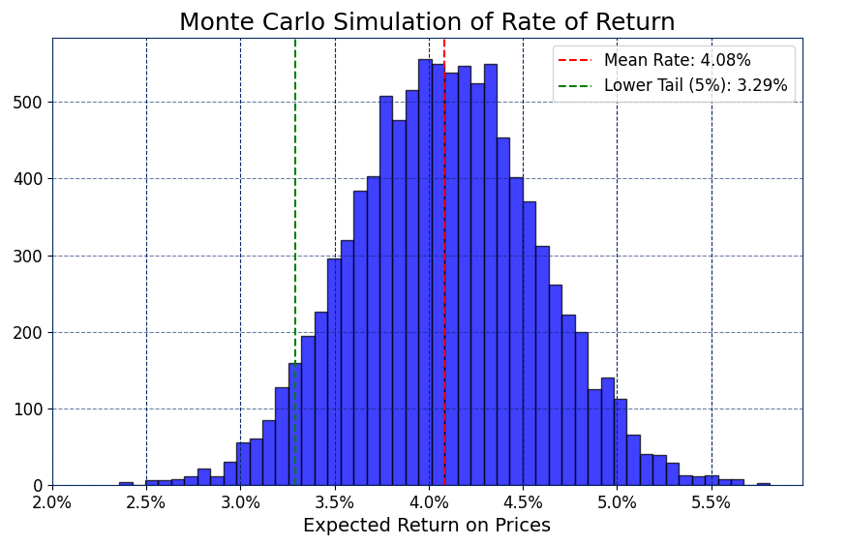
Mc Simulation for interest rate changes
Expected Return: 4.08%
Important Restrictions:
Assumes a uniform distribution of rate changes within range of -100 bps and +50 bps
No coupon payments and does not consider exchange rate volatility

Slide 12
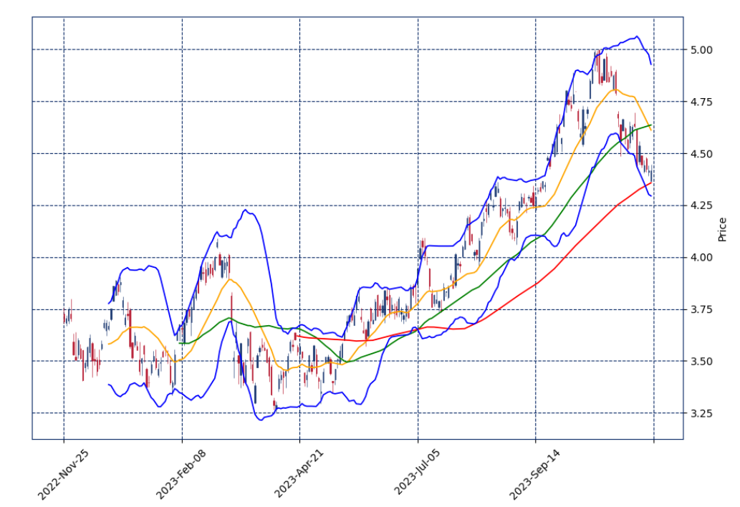
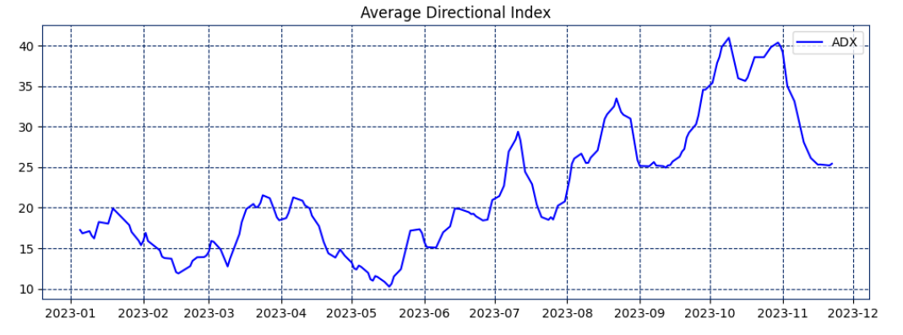
Technical analysis for short-term yield movements
Further Investigation: Using Python’s mplfinance and yfinance, could the US yield movements be predictable?
Trend Indicator: Moving Averages…
Mean-Reversion: Bollinger Bands…
Momentum Indicators: ADX, RSI…

Slide 13
RISK CONSIDERATIONS

Slide 14
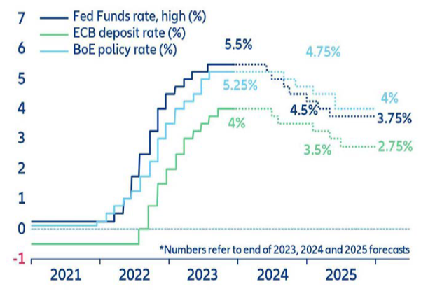
Inflatıon and interest rate rısk
Even though risks persists, inflation started to cool down
Starting from 2024Q2, interest rate cuts may start
Expectation: decline of the yields of shorter-terms, advantage with duration gains
Data Source: OECD Economic Outlook, November 2023
Source: Allianz SE, Global Economic Outlook 2023-25

Slide 15
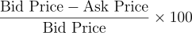
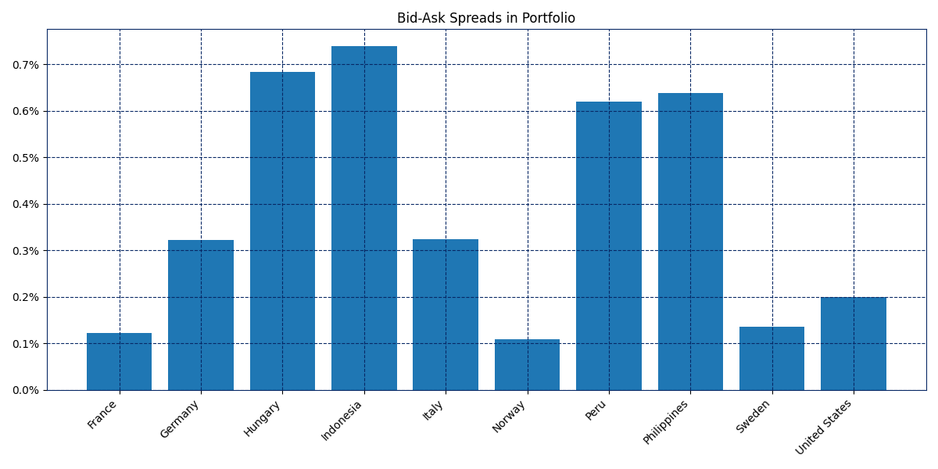
Lıquıdıty rısk
Given the cross-sectional nature of data, the liquidity proxy is: Bid-Ask Spread
Selected method for the liquidity proxy is:
Average bid-ask spread of the portfolio: 0.29%
Average bid-ask price difference is: 2.63$

Slide 16
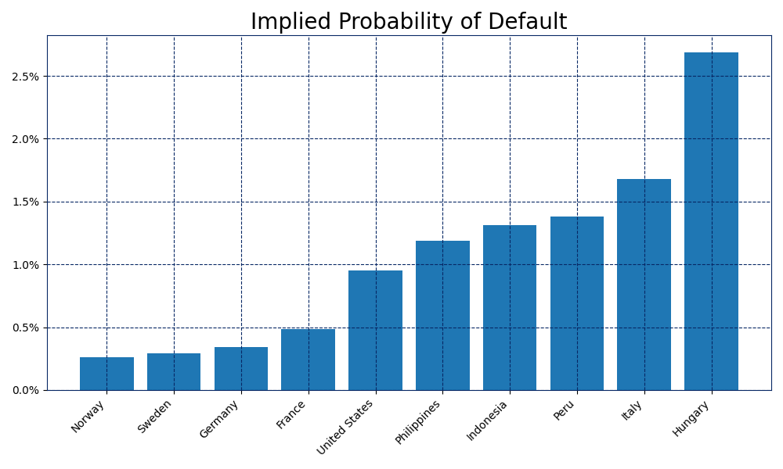
Credıt rısk
High credit rating: AA+ ≥ 90%
Except Hungary, no implied PD above 2%
Due to time constraints, the missing parts:
“Negative basis trade” opportunities
Credit risk hedging using CDS

Slide 17
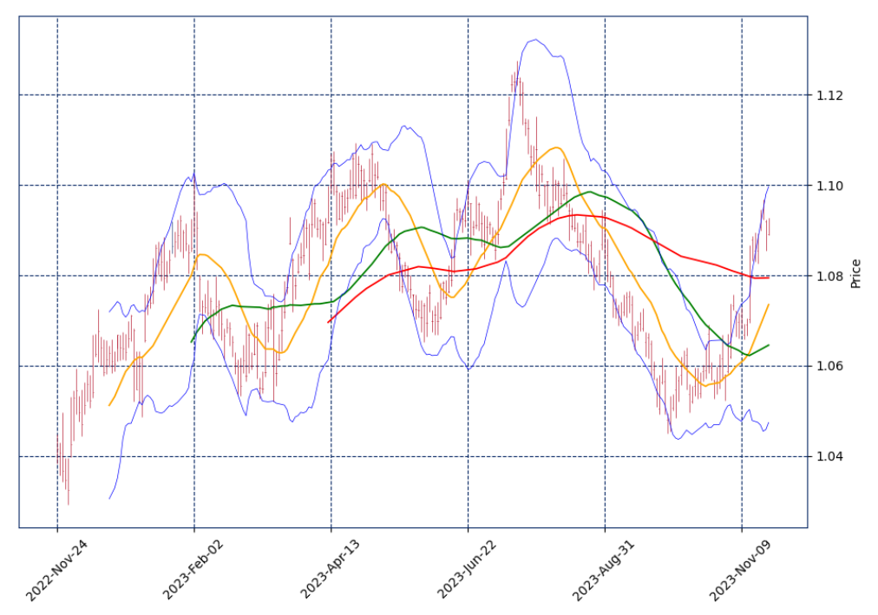
EXCHANGE RATE RISK
7.57% of total amount of money invested in Euro-denominated bonds
For portfolio metrics, values are converted to USD using EURUSD on November 24, 2023
Simulations must consider exchange rate volatility
EURUSD

Slide 18
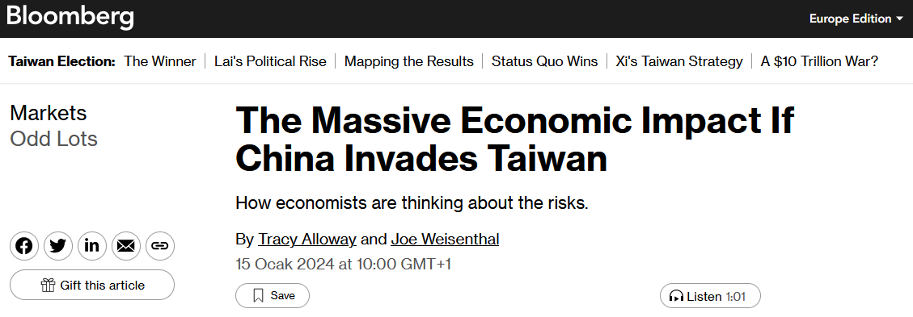
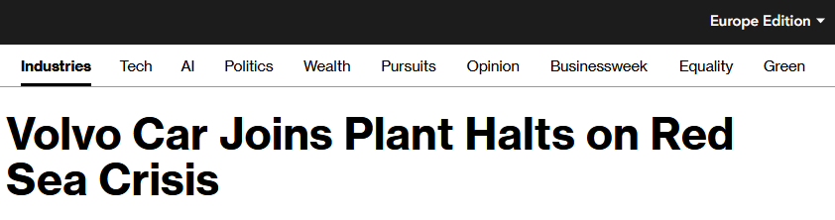
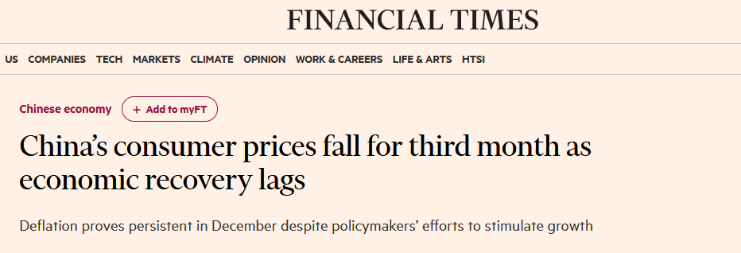
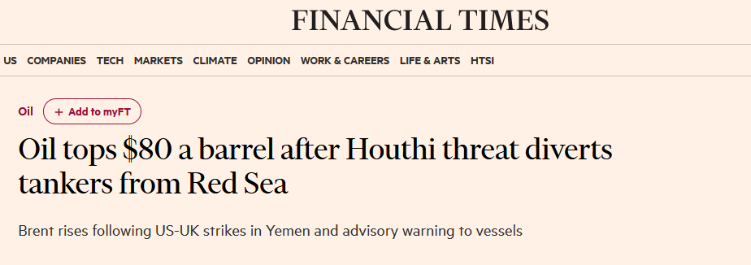
Geopolıtıcal rısk
Avoid Chinese and Middle Eastern bonds
Rising political and military tensions → increasing financial volatility → unforeseeable risks
In a nutshell, no additional risk without proportionately additional reward

Slide 19
THANK YOU
Alper Yıldırım
yildirimalper@outlook.de

